Slide 1
Using Minecraft to leverage university student’s digital modes of engagement in the classroom
SYMPOSIUM on NEW WORLD OF EDUCATION - India
October 21st, 2020
Dr. Alexandra Bal, Associate Professor,
New media Program @ FCAD, Ryerson University,
Toronto, Canada.

Slide 2

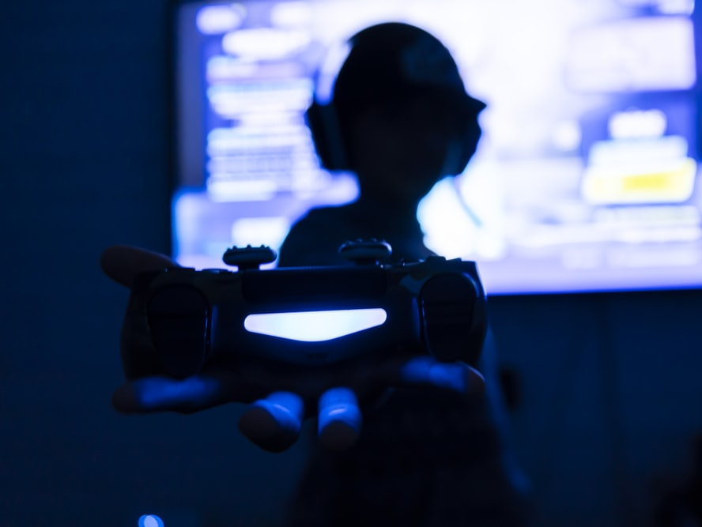
MOTIVATION
Digital natives are entering universities.
They social lives exist within virtual environments, such as Minecraft
Many have years of experiences with
peer to peer digital communication styles,
experiential and active learning approaches,
Verse with invisible social characteristics of these environments.
Image source: The game - nicolas perez @nikochile

Slide 3
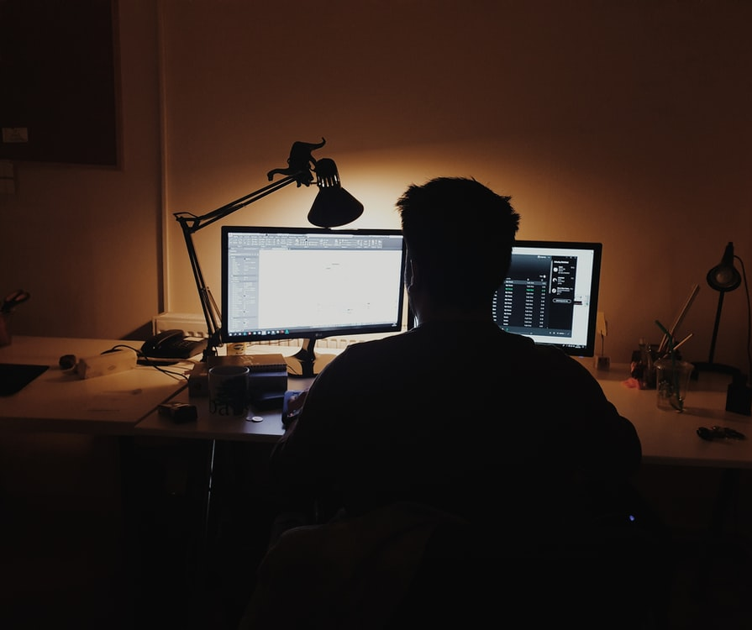
The Covid Crisis
Virtual models of education:
  highly impersonal communication tools such as Zoom.
When educators focus on presentation modalities, such as the lecture model
Risk of increased isolation and disengagement
Should implement existing learning principles specific to digital environments.
Image source: Oğuzhan Akdoğan @jeffgry

Slide 4
PROBLEM STATEMENT
Digital natives use different modes of communication than previous generations.
Nonverbal embodied communication is being replaced with nonverbal virtual communication.
How can we, as educator, build a bridge between these two different approaches to being in the world?

Slide 5
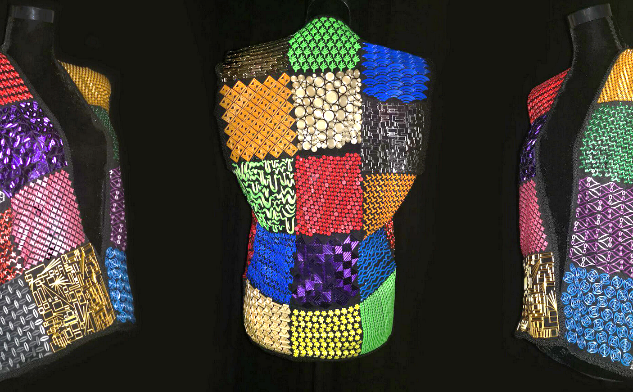
New media program
Arts Education → Innovative thinking
Maker culture
Learning by making
Creative problem solving
Empathic makers
Technology/Art
  3D Printed Materials
  Robots
  Electronics
  Virtual/AR/VR
  Audio/Visual work
Before You Fly Off - Neekta Torabian

Slide 6
RTA 107 Creative processes
Learning Objectives :
Students will increase their capacity at being
  Curious
  Fearless (Self-confident, Adaptable & Resilient)
  Problem Solvers
  Empathic
  Students
    hone and develop their creative voice and identity,
    hone and develop autonomous learning strategies and creative processes,
    Be exposed to new media cultures
    develop a new media community - Introduction to the maker space
      Share their work
      Talk about their work
      Discover their own strengths and others

Slide 7
2020 virtual Challenges
1st year students are new…
How to build a maker community?
How to facilitate social interactions, dialog, conversations, feedback?
How to make virtually?
How to engage students meaningfully?
How to foster curiosity, taking chances, failing as a learning path to success, fun as a core creative value?

Slide 8
methodology
This autoethnographic project examines whether Minecraft can be used effectively as a virtual classroom at the university level for creative/studio courses
Can we successfully leverage digital natives existing maker and creative knowledge as well as their informal learning processes and environments in the university classroom.

Slide 9
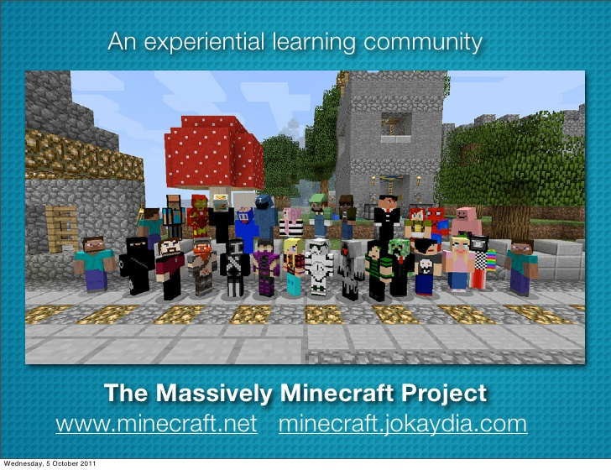
MINECRAFT
A highly collaborative sandbox
Fosters engagement of players
Active, experiential and social learning are embedded in the culture of this space
A very large informal community of learners.

Slide 10
In class experimentation
1/3 of the course is taking place in Minecraft
Digital natives use informal learning environment which already have rules of engagement, specific approaches to learning and foster collaborative collective behaviors that address these challenges.
During the winter term, we will explore whether Minecraft is useful as a virtual classroom at the university level for academic contexts such as art history.

Slide 11
RESULTS
Minecraft facilitates the creation of a virtual social space for students to build a community and co-create knowledge on their own terms.
It fosters students’ soft skills development (collaboration, emotional intelligence, peer evaluation) in an inclusive and non-competitive safe environment.
Minecraft and Discord flatten the teacher/student relationship and create an atmosphere where students feel free to co-create the learning experience with each other and faculty members.
Students become much more animated, autonomous, and genuine in their interactions with instructors.

Slide 12
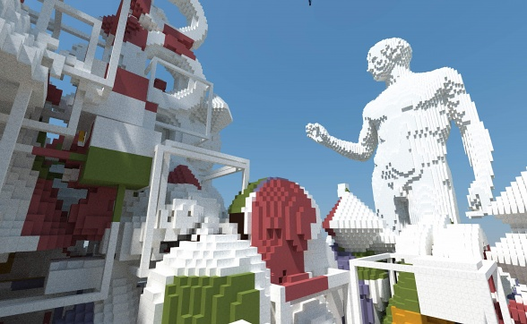
Knowledge co-creation

Slide 13
implications
This work will add to academic and industrial knowledge on the use of Minecraft as an educational tool for higher education. It will also provide a case study for the blending of digital natives’ informal learning approaches to formal institutional learning methodologies.
Different approach to workforce communication and virtual behaviors
Different approach to learning

